Slide 1

Tuberculosis
Dr.maha elkholy
Professor of respiratory medicine

Slide 2
TB is an infection with mycobacterium tuberculosis.
It is one of the top causes of all deaths worldwide.
Spread: Respiratory droplet from person to person.

Slide 3
Specific risk factors for exposure:
Health care workers
Prisoners
Homeless
Shelter residents
Chronically debilitated patients with weakened immune system
lymphoma, leukemia, HIV, steroid use, organ transplant, chemotherapy, immunosuppressive.

Slide 4
Presentation
Fever
Cough> 3 weeks
Sputum
Weight loss
Night fever
Hemoptysis
Any part of the body could be involved in 15-20% of cases. ( lymph node, meninges, gastrointestinal system, genitourinary system, etc)

Slide 5
Signs
Sometimes difficult to distinguish from pneumonia
Commonly presented with apical fibrocavitary lesion.
Restricted mobility and retraction on the affected side.
Decrease or heterogenous TVF & trachea shifted to same side of the lesion.
Impaired note on affected side.
Bronchial breathing and crepitations on affected side.

Slide 6
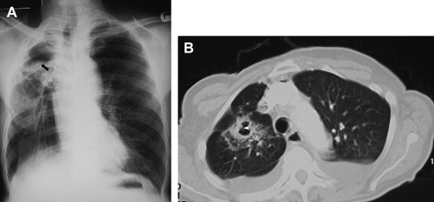
Diagnosis
clinical
Chest x ray
  Apical involvement with infiltrate and sometime cavitation is the most common finding.
  Adenopathy, effusion and calcified nodules are associated finding.

Slide 7
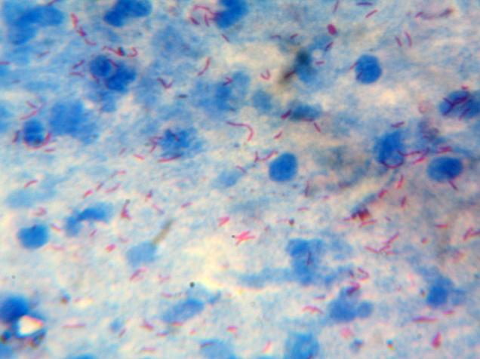
Sputum examination :
  direct smear with Zeihl neelsen stain (AFB)
    (25% is false negative)
    Trigger the treatment
  culture on Lowenstein Jensen media.
    Culture considered a gold standard but take 6 weeks to grow.
    Culture is important for sensitivity.

Slide 8
Thoracocentesis: if there is pleural effusion.
Pleural fluid adenosine deaminase could be helpful.
Pleural biopsy (75% sensitivity)
Gastric aspirate in children
Lymph node biopsy
Fine needle aspiration (FNA) of specific extrapulmonary involved organ.
  Biopsy could reveal caseating necrosis.

Slide 9
Lumbar puncture in meningitis
Gene expert: to diagnose TB and rifampicin resistance in two hours.
Diagnosis of latent TB in which absence of symptoms and normal x ray: tuberclin test , interferone gamma release assay (IGRA).

Slide 10
Treatment
Drug | Dose | Side effects
Isoniazide (INH) or (H) | 5 mg/Kg | Peripheral neuritis, hepatitis, hypersensitivity
Rifampicin (Rif) or (R) | 10mg /Kg | Orange urine Flu like illness Hepatitis Hypersensitivity Blood dyscriasis
Ethambutol (ETB) or (E) | 25mg/Kg for two months, then 15mg/Kg | Retrobulbar neuritis
Pyrazinamide (PZA) or (Z) | <50Kg,1.5g 50-74Kg, 2g >75Kg, 2.5g | Hepatotoxicity, Hyperuricaemia
Streptomycin (S) | 20mg/Kg (max 1g) | Ototoxicity (vestibular) Nephrotoxicity Hypersensitivity

Slide 11
New case :
either pulmonary or extrapulmonary 6 month regimen
2 months Isoniazide (INH), Rifampin (Rif), Ethambutol (ETB), Pyrazinamide (PZA)/ 4 months Isoniazide (INH) and Rifampicin (Rif).
Forms of TB that must be treated for more than six months: TB meningitis (12 months), TB in pregnancy and osteomyelitis (9 months)
HIV positive (6 or 9 months)
Use of INH must be combined with vit B6 to prevent peripheral neuropathy.

Slide 12
Previously treated smear positive patients
2 SRHZE/1 RHZE/5 RHE (8 month regimen)
Sensitivity pattern is recommended

Slide 13
Chronic smear positive patient& MDR-TB & X TB
Treated in hospital
Sensitivity pattern is recommended to give special treatment regimen.

Slide 14
Indications of steroid in tuberculosis
In very ill patient.
To control drug hypersensitivity.
In tuberculosis of serous sacs pericarditis, peritonitis and pleural effusion.
In tuberculous meningitis.
Genitourinary tuberculosis.

Slide 15
Diagnosis and treatment of latent TB
Latent TB mean when a person is infected with Mycobacterium tuberculosis, but does not have a disease.
Patients with a clinically significant result on tuberculin skin testing or a positive interferon-gamma release assay (IGRA) should receive a course of therapy for latent TB, once active infection and disease are ruled out.
Isoniazid 300 mg - Daily for 9 months or
Rifampin 600 mg - Daily for 4 months.

Slide 16
MCQs
Which one of the following is contraindicated in tuberculous patient suffered from chronic renal failure?
  Rifampicin.
  Isoniazide
  Pyrazinamide
  Ethambutol
  Streptomycin

Slide 17
A 25 year old patient presented to ER with fever, cough and hemoptysis of one month duration, which of the following investigations is recommended?
  Pulmonary function test.
  Sputum analysis for tuberculosis (AFB)
  Tuberclin test
  Interferone gamma release assay (IGRA)
  Bronchoscopy

Slide 18
Which one of the following is not a sign of right fibro-cavitary lesion?
  Retraction on right side
  Trachea shifted to left.
  Impaired note on right side
  Bronchial breathing
  Crepitations

Slide 19
A 48 year old male patient suffer from chronic liver disease develop pulmonary tuberculosis, which one of the following antituberculous drugs should be avoided?
  Streptomycin
  Azithromyin
  Rifampicin
  Ethambutol
  Flouroquinolone

Slide 20
Which one of the following is an indication of steroid in tuberculosis?
  Pulmonary tuberculosis.
  Tuberculous pleural effusion
  Liver tuberuloma
  Tuberculous cervical lymphadenopathy.
  Tuberculous enteritis

Slide 21
Which test is helpful for screening of latent TB?
    Sputum direct smear for AFB
    X ray
    Bronchoalveolar lavage
    IGRA
    Gene expert

Slide 22
A 25 female patient develops pulmonary tuberculosis, For how long she must receive anti TB treatment?
  2 months
  6 months
  8 months
  12 months
  16 months

Slide 23
Which one of the following is the most common presentation?
  Pulmonary collapse
  Fibrocavitary lesion
  Pleural effusion
  Pulmonary nodule
  Consolidation

Slide 24
Which one of the following is a side effect from pyrazinamide?
  Peripheral neuropathy
  Impairment of renal function
  Retrobulbar neuritis
  Ototoxicity
  Hyperuricemia

Slide 25
A 31 year old male newly diagnosed with pulmonary TB, which one of the following regimens is suitable for her?
  Isoniazide 300 mg daily for 9 months
  Rifampicin 600mg daily for 6 months
  2 months Isoniazide (INH), Rifampin (Rif), Ethambutol (ETB), Pyrazinamide (PZA) followed by 4 months Isoniazide (INH) and Rifampicin (Rif).
  4 months Isoniazide (INH), Rifampin (Rif), Ethambutol (ETB), Pyrazinamide (PZA) followed by 2 months Isoniazide (INH) and Rifampicin (Rif).
  4 months Isoniazide (INH), Rifampin (Rif), Ethambutol (ETB), Pyrazinamide (PZA) followed by 4 months Isoniazide (INH) and Rifampicin (Rif).

Slide 26

Thank you

